Slide 1
Building Llama3
TA: Jason, Tommy

Slide 2
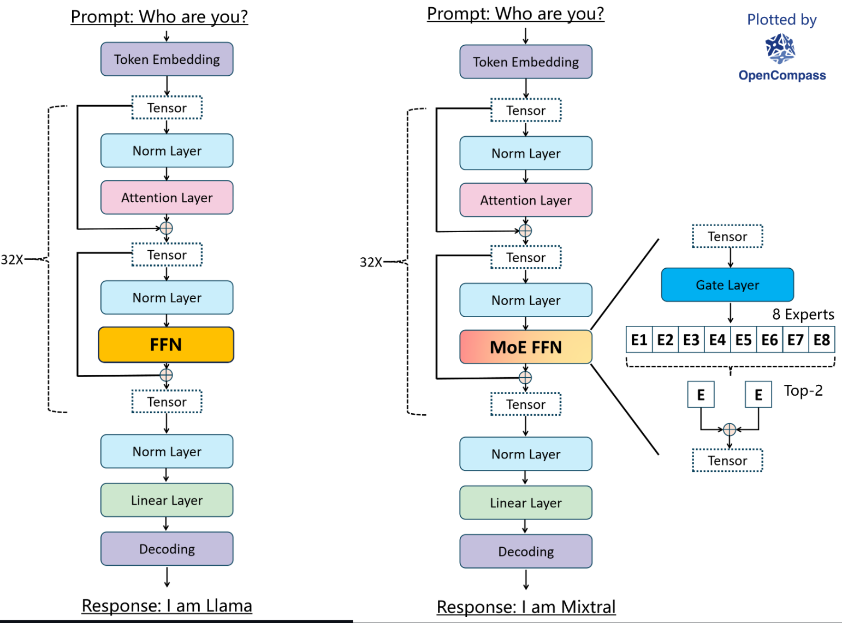

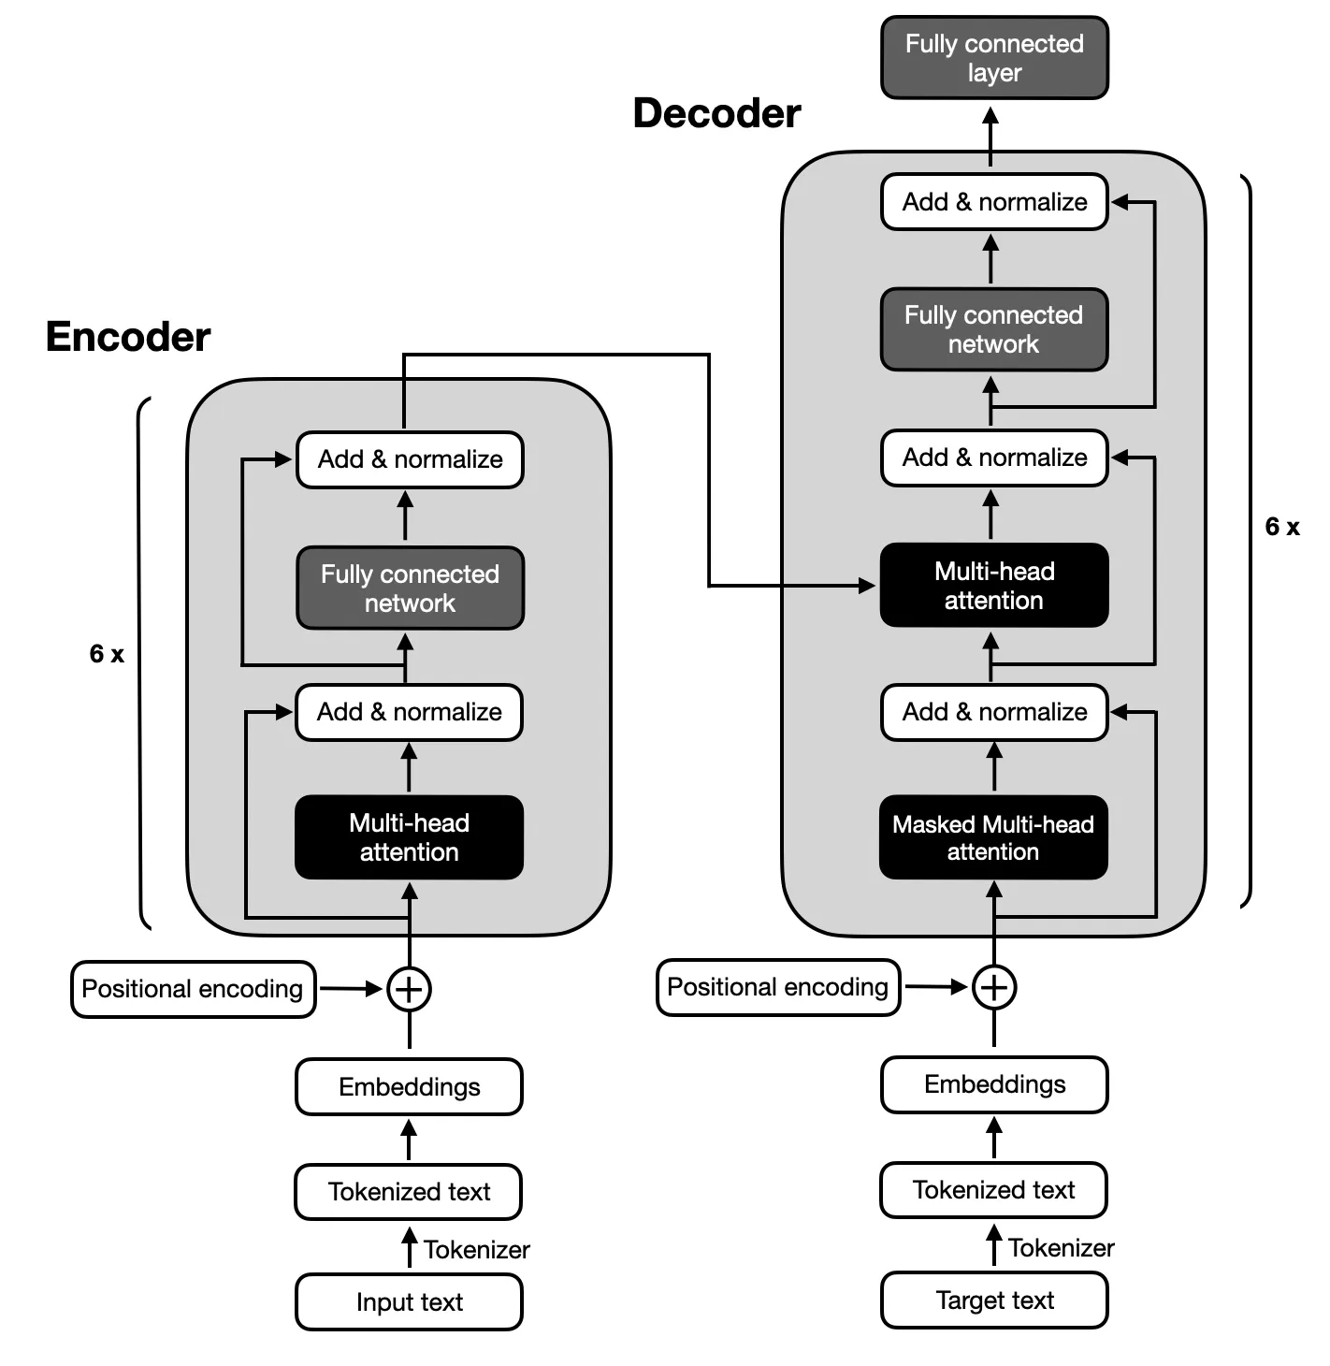
LLM design variations
Architecture:
encoder-decoder: Flan-T5, BART
decoder-only: GPT-series, Llama-series, PaLM
mixture of experts: Mixtral (build on decoder)

Slide 3
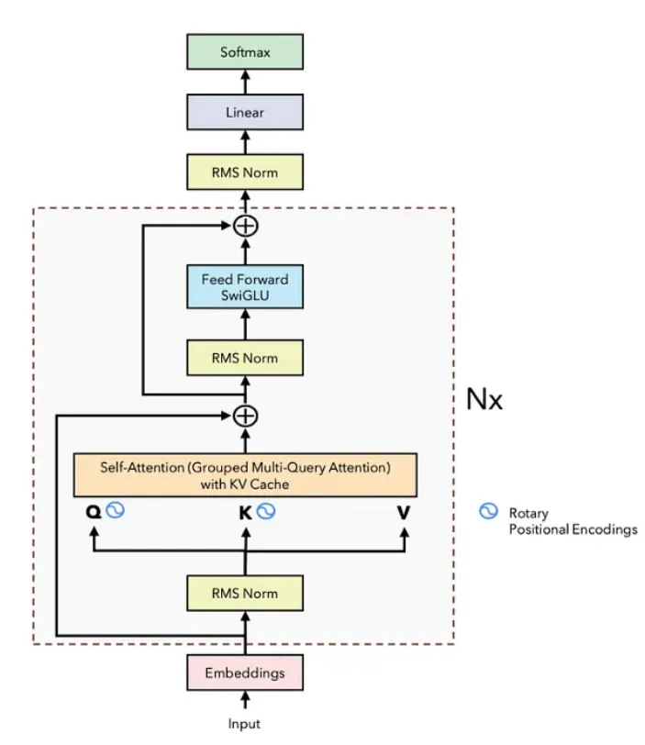
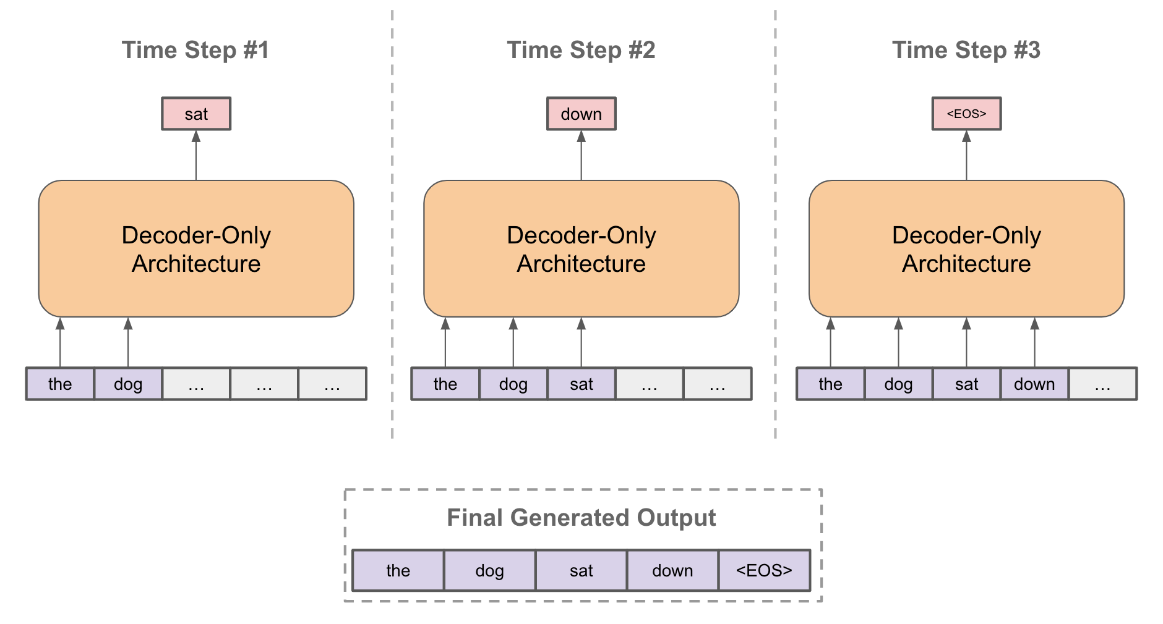
Llama3 architecture
When autoregrssively generating the next token, decoder can only see preceding tokens.
Differences between Llama3 and traditional decoder model
Rotary positional embedding
Grouped Query-attention
SwiGLU

Slide 4
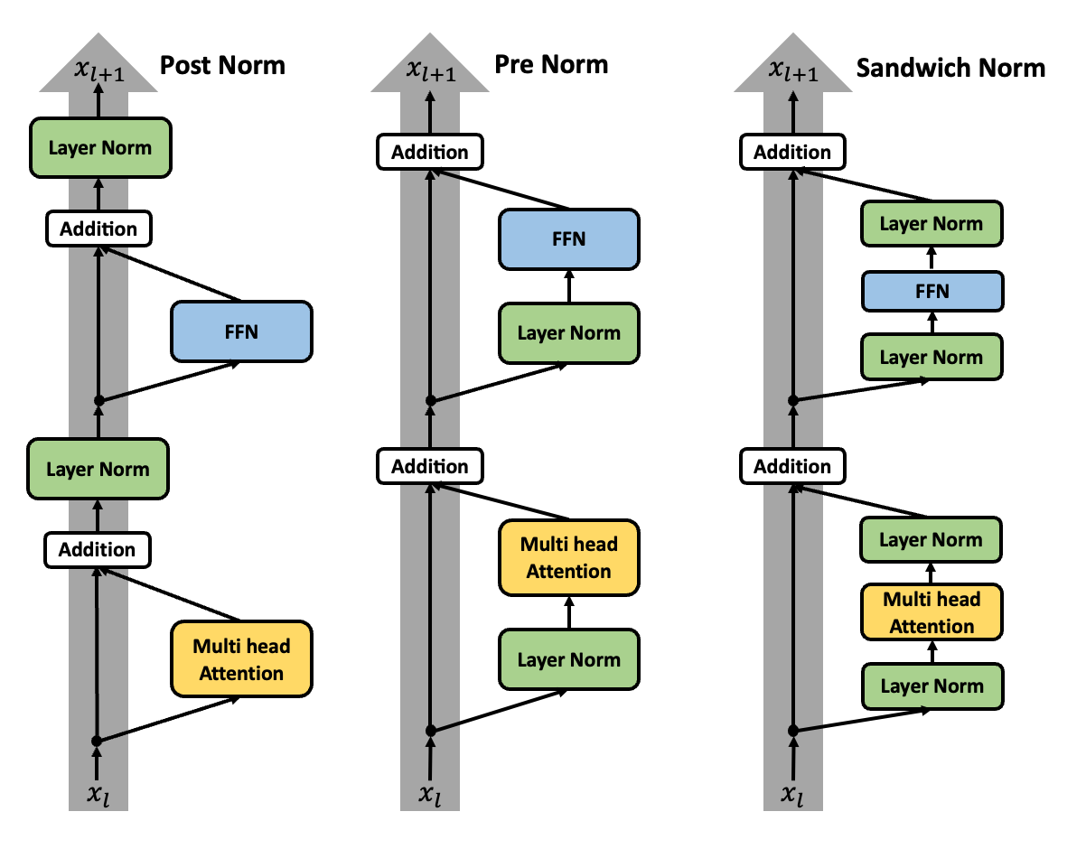
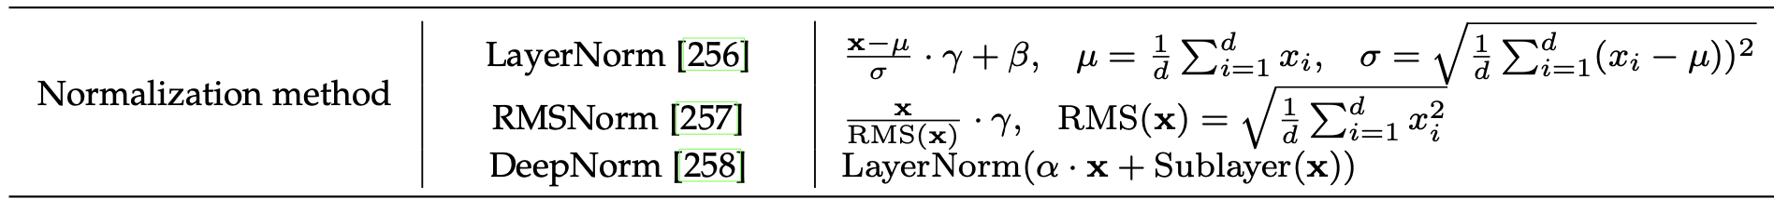
design variants -normalization
goal: scale features to a controlled range to stabilize the training of NN
methods:
LayerNorm: normalize across feature dimensions
RMSNorm: simplification of LN, faster
DeepNorm: learnable weight instead of simple residual, best for very deep NN (>100 layers)
position:
pre
post
sandwich
Llama3: pre+RMS Norm
Implementation: 𝛾 is learned in training, RMS(x) is calculated during forward

Slide 5
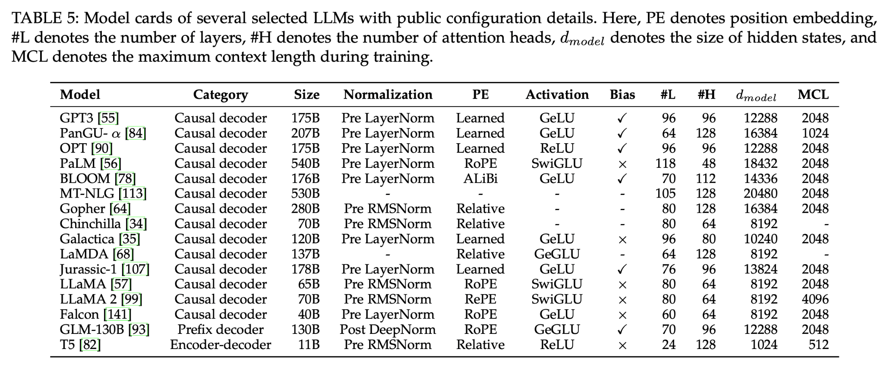

Slide 6
design variants -positional embedding
goal: injects position information for modling language sequence
methods:
absolute position embedding: can’t generalize to unseen positions, no relative information
relative position embedding: extra delay, can’t use KV cache
rotary position embedding: rotate the embedding according to its position and depth(dimension)
relative information is indicated by angles
can use KV cache
Alibi position encoding: better extrapolation ability (generalize to unseen long sequence)
Llama3: rotary positioin embedding

Slide 7
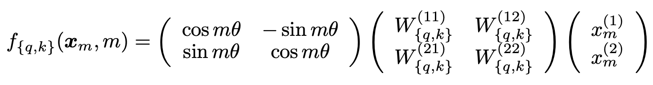
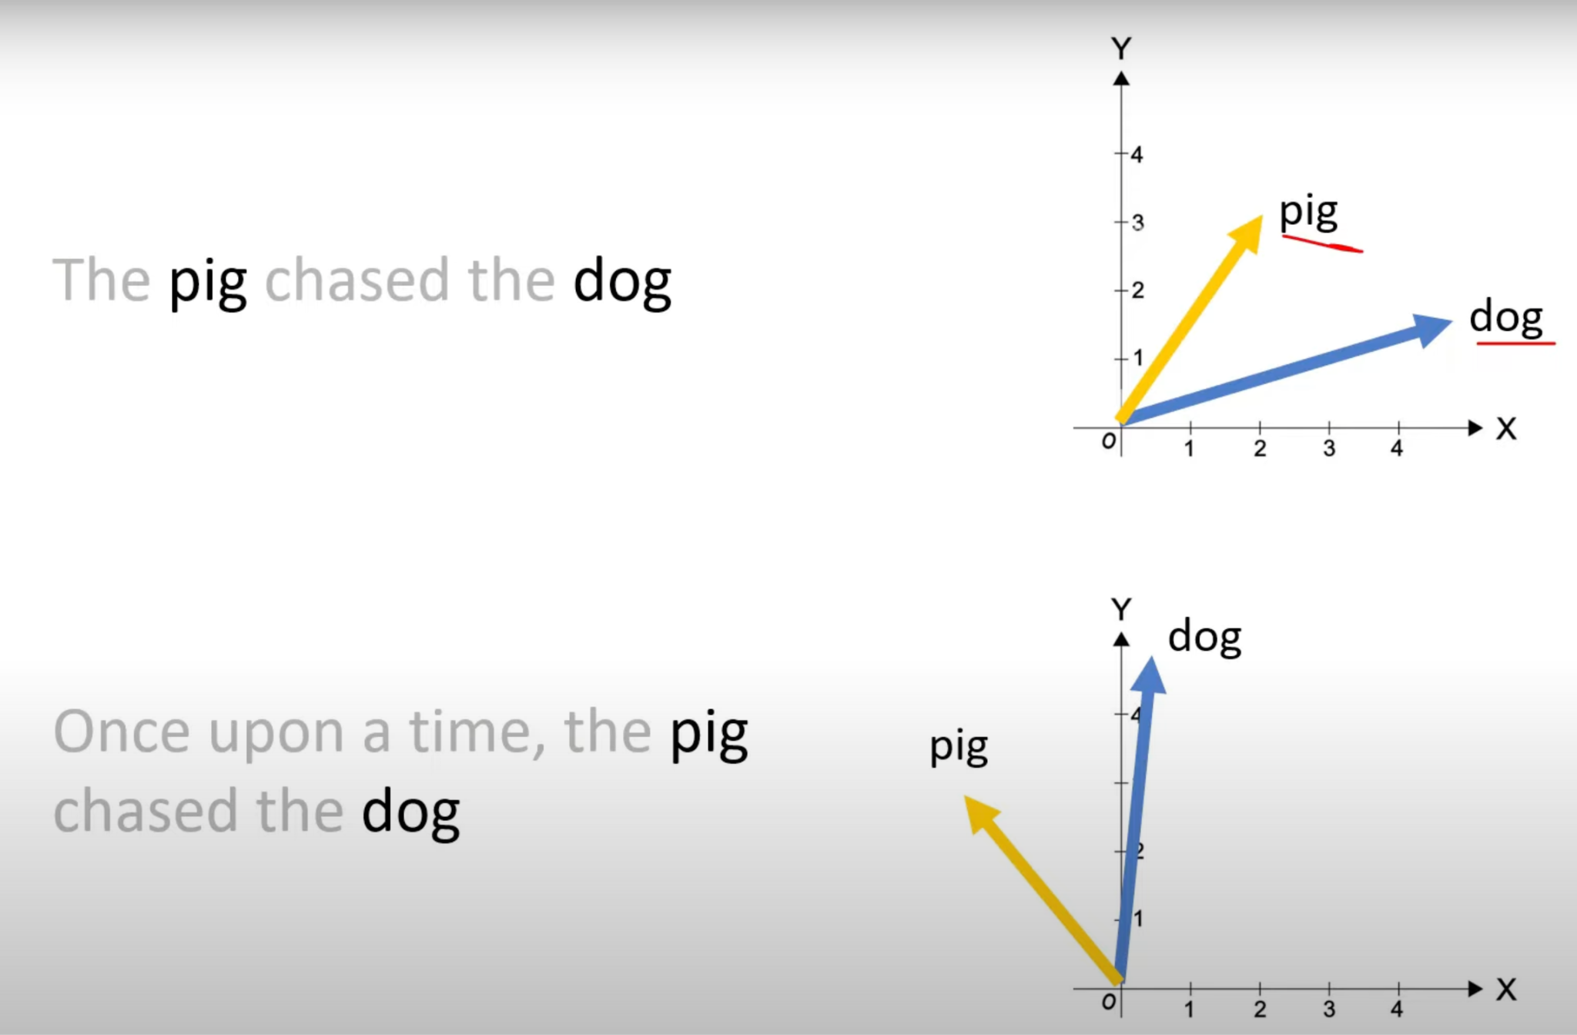
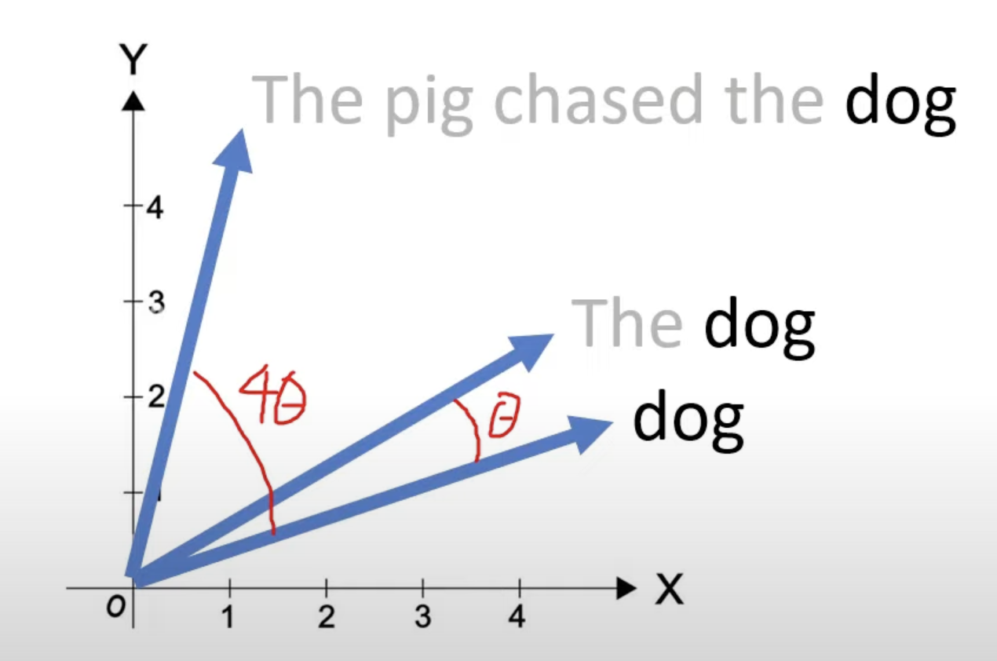
RoPE detailed
Rotate an embedding based on its position

Slide 8
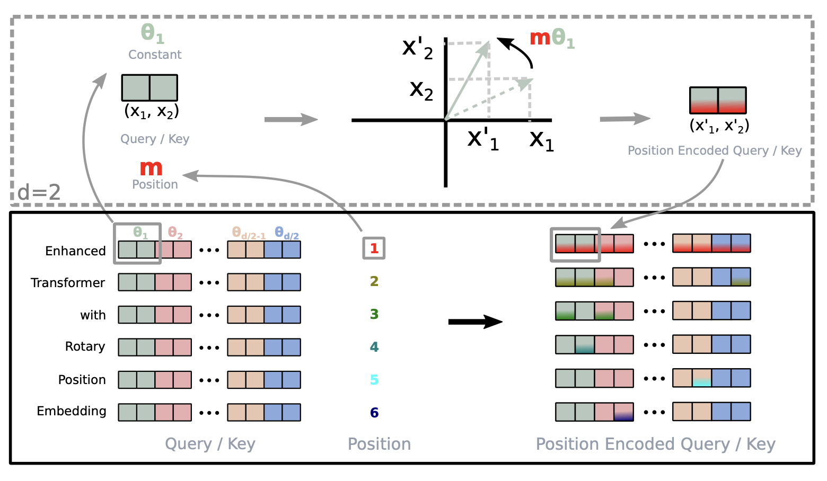
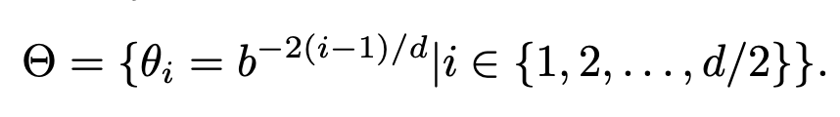
RoPE detailed
2D rotation
The rotation angle depends on the dimension depth and the position
Steps: 1. project embedding X by Query/Value matrix (Wq, Wk) 2. split Xq, Xk to 2-d embedding 3. rotate 2-d embedding by mΘi (b: rope theta) rotate slower in deeper dimension
Multi-dimension rotation

Slide 9
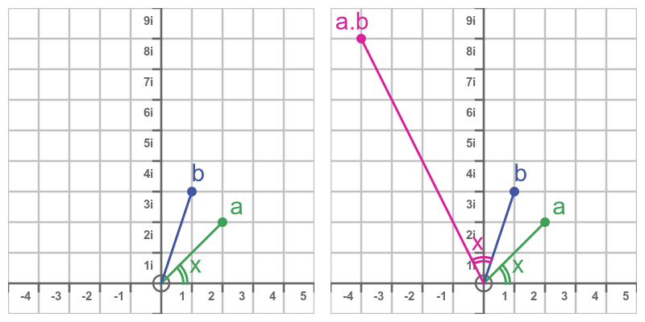
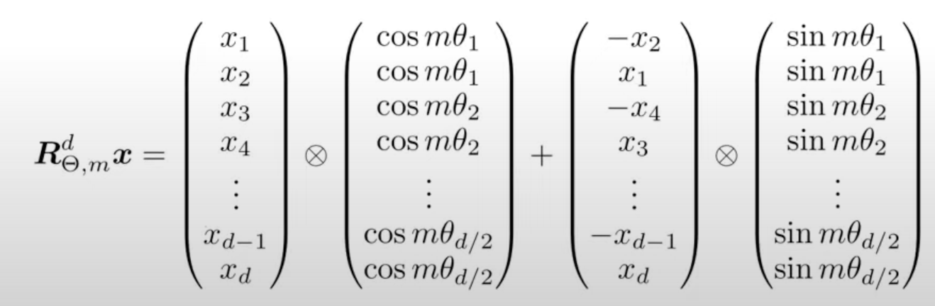
Rotation implementation
Matrix multiplication
Complex number multiplication: turn 2-d embedding and rotation matrix into complex numbers, multiplication of complex numbers equals to rotation operation.

Slide 10
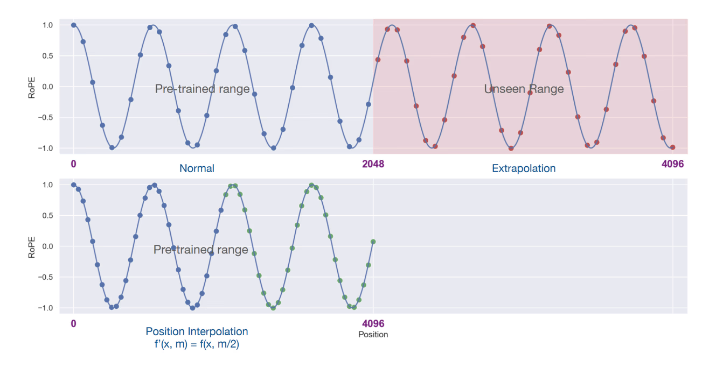
Extrapolation of RoPE
Reference: https://gradient.ai/blog/scaling-rotational-embeddings-for-long-context-language-models

Slide 11
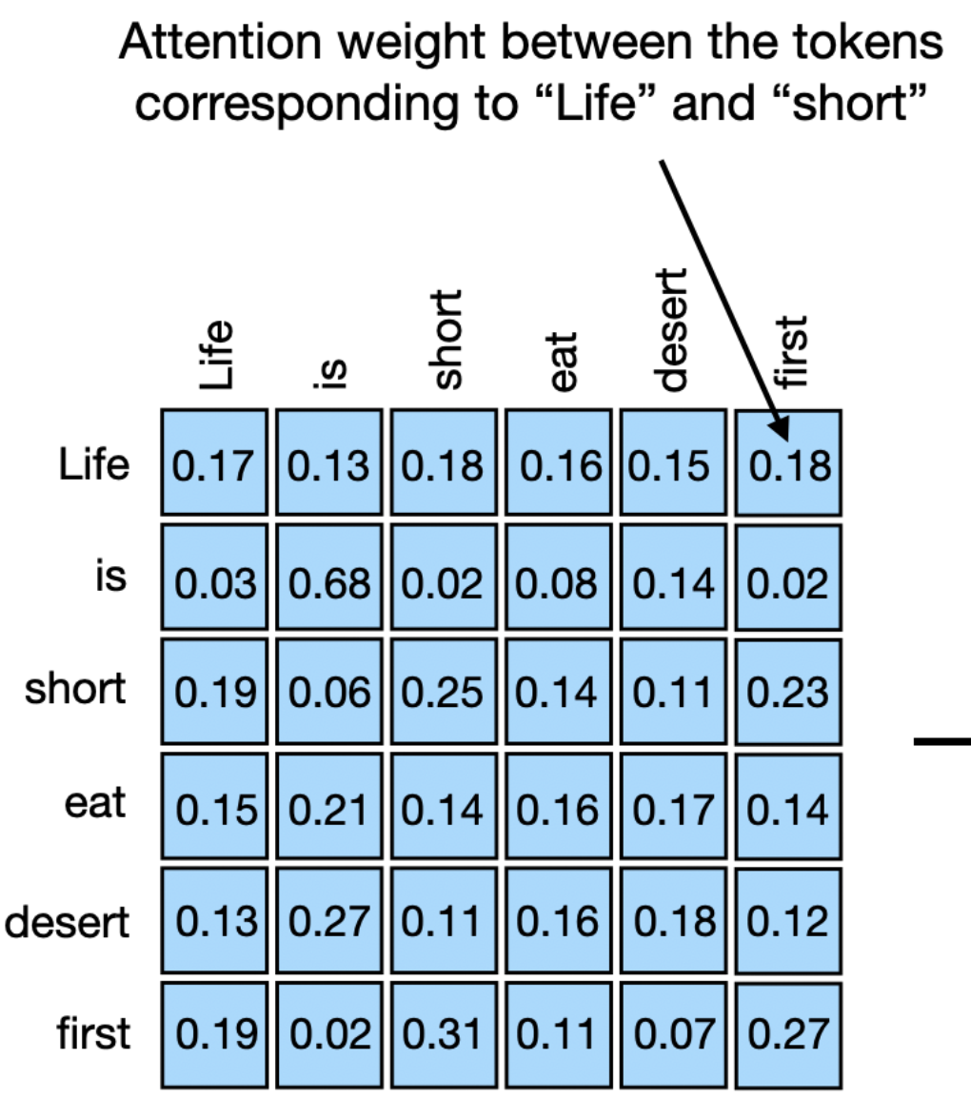
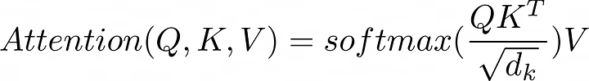

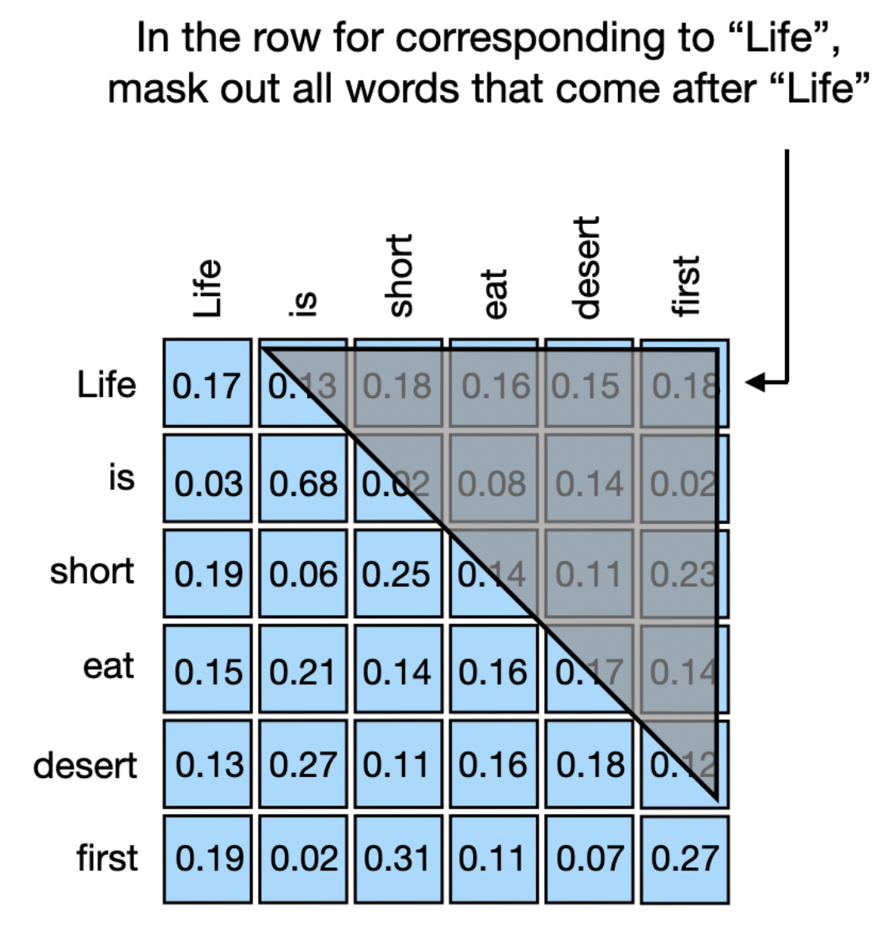
Multi-head attention (brief recap)

Slide 12
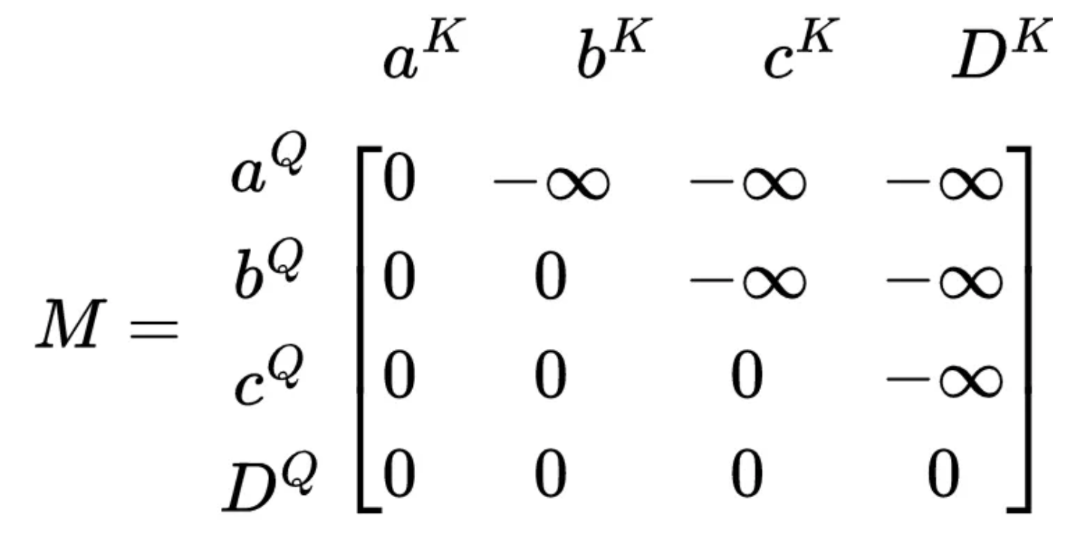
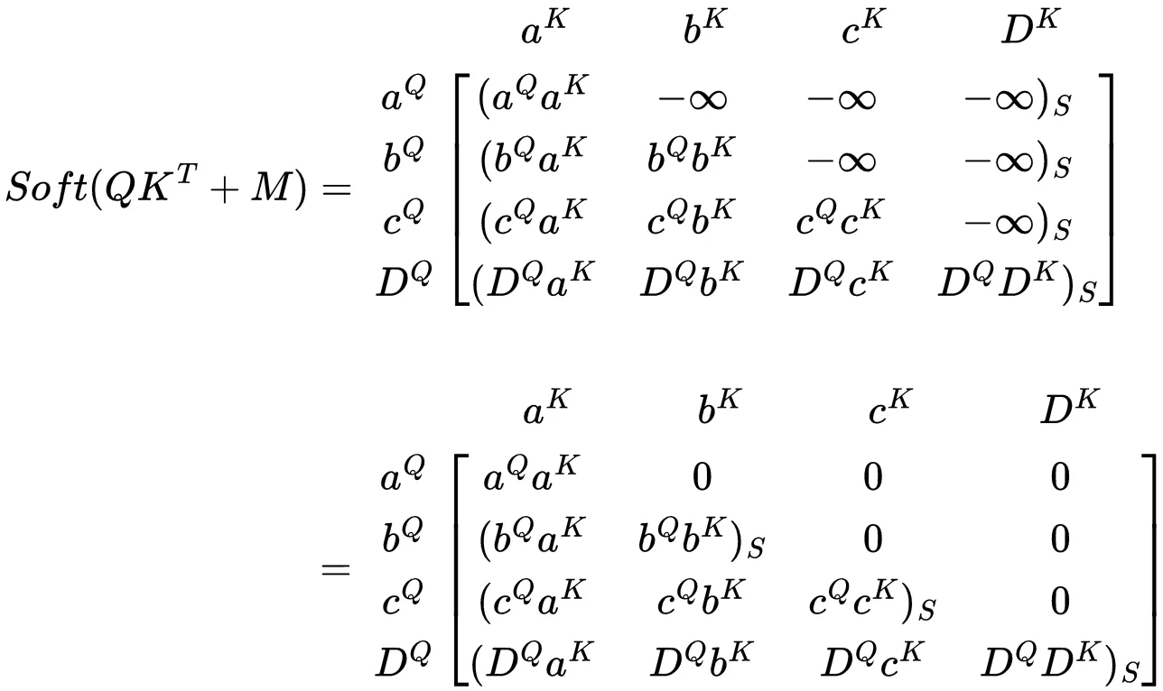
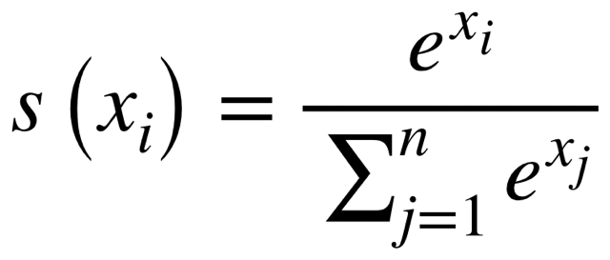
Mask implementation
In practice, we mask the qk matrix before the softmax

Slide 13
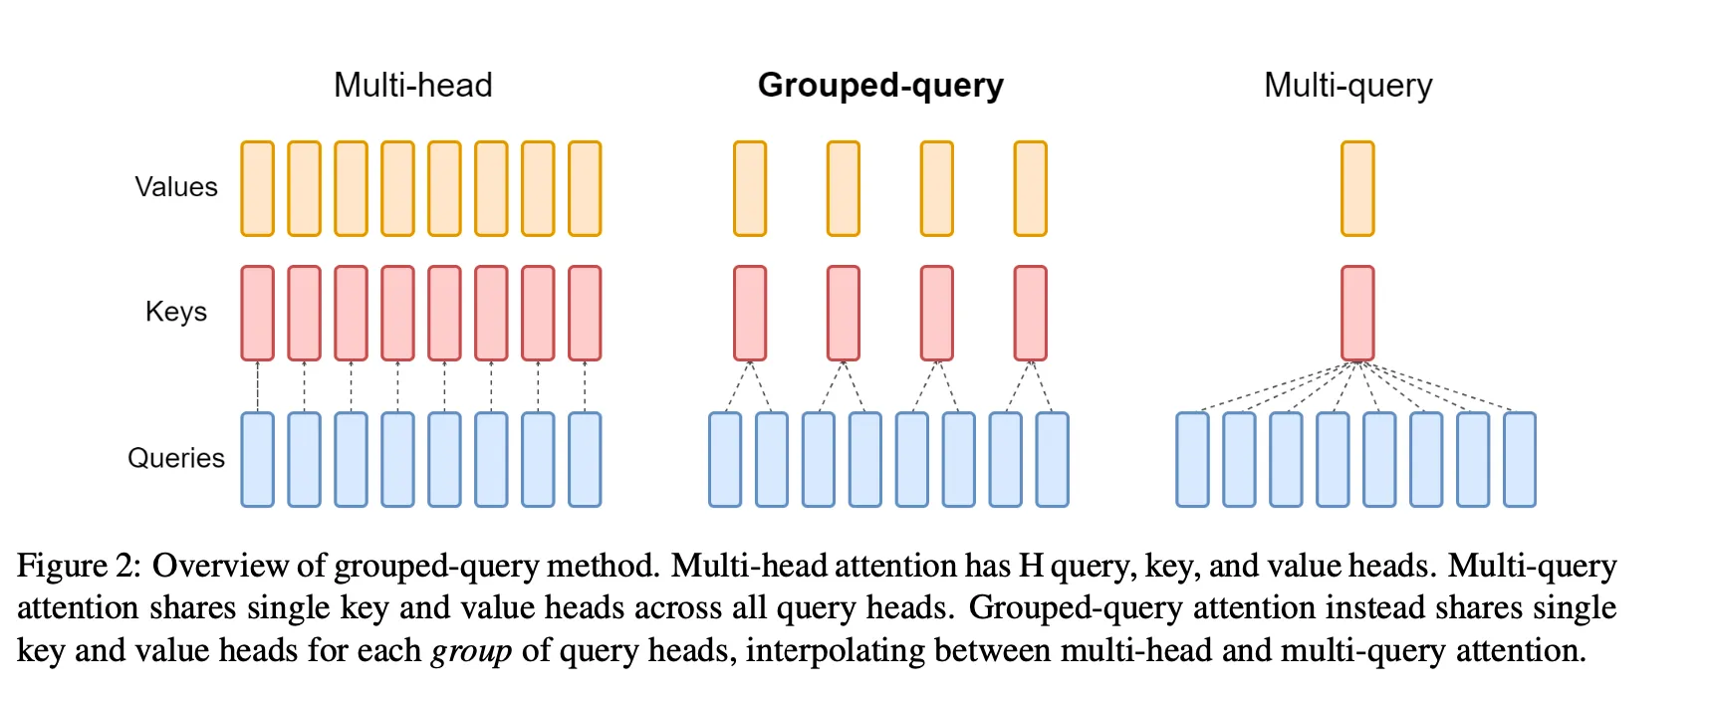
Grouped-query attention
Efficiency and Accuracy tradoff Several query share the same key/value For Llama3, 32 heads are divided into 8 groups (4 heads per group)

Slide 14
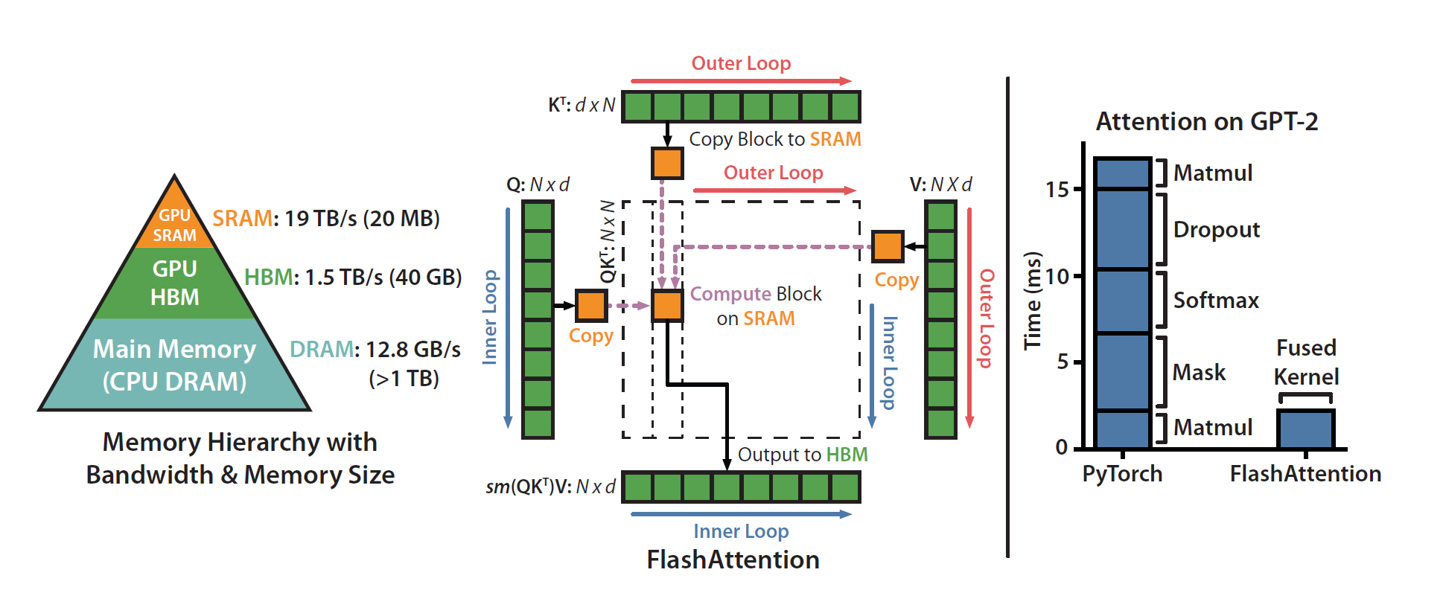
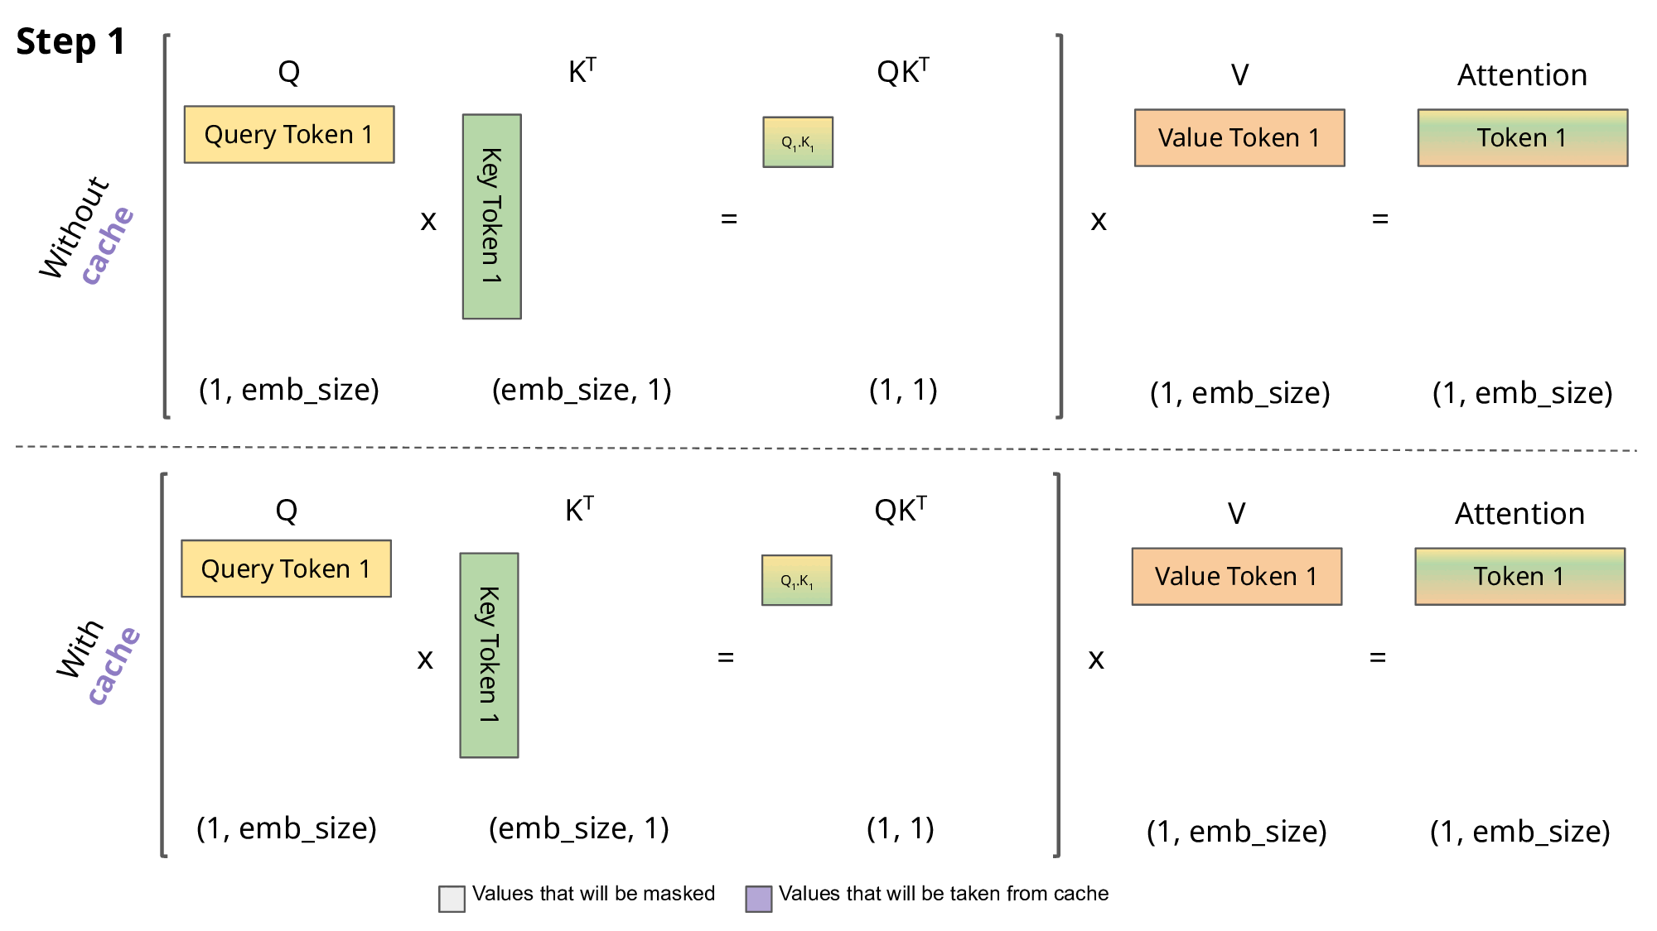
Other attention optimizations
KV cache: cache past keys and values of previous tokens
Flash attention: Hardware optimization - fragment attention computation into blocks to speed up memory IO.
Paged attention: memory-efficient kv caching

Slide 15
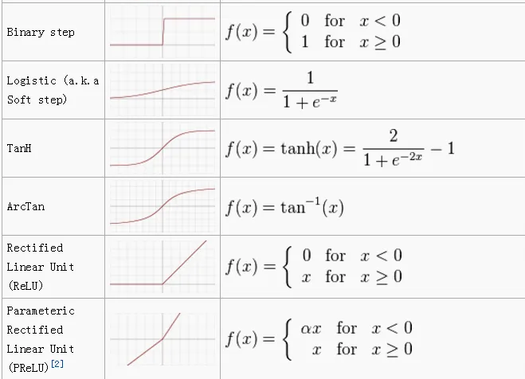
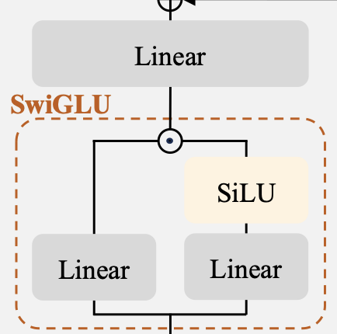
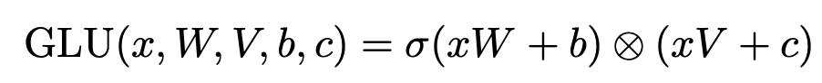
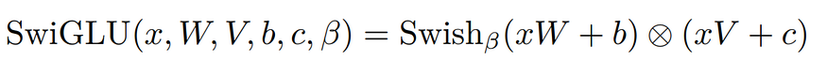
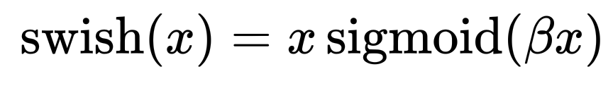
design variants -activation functions
usually used in FFN, allow it to learn complex patterns with non-linear transforms
methods:
Direct non-linear transform
GLU (gated linear units): combines non-linear transform and linear transform variants: swish function, gaussian error function
Llama3: SwiGLU
implementations: W, V are learned wights, 𝛃 is pre-defined parameter

Slide 16
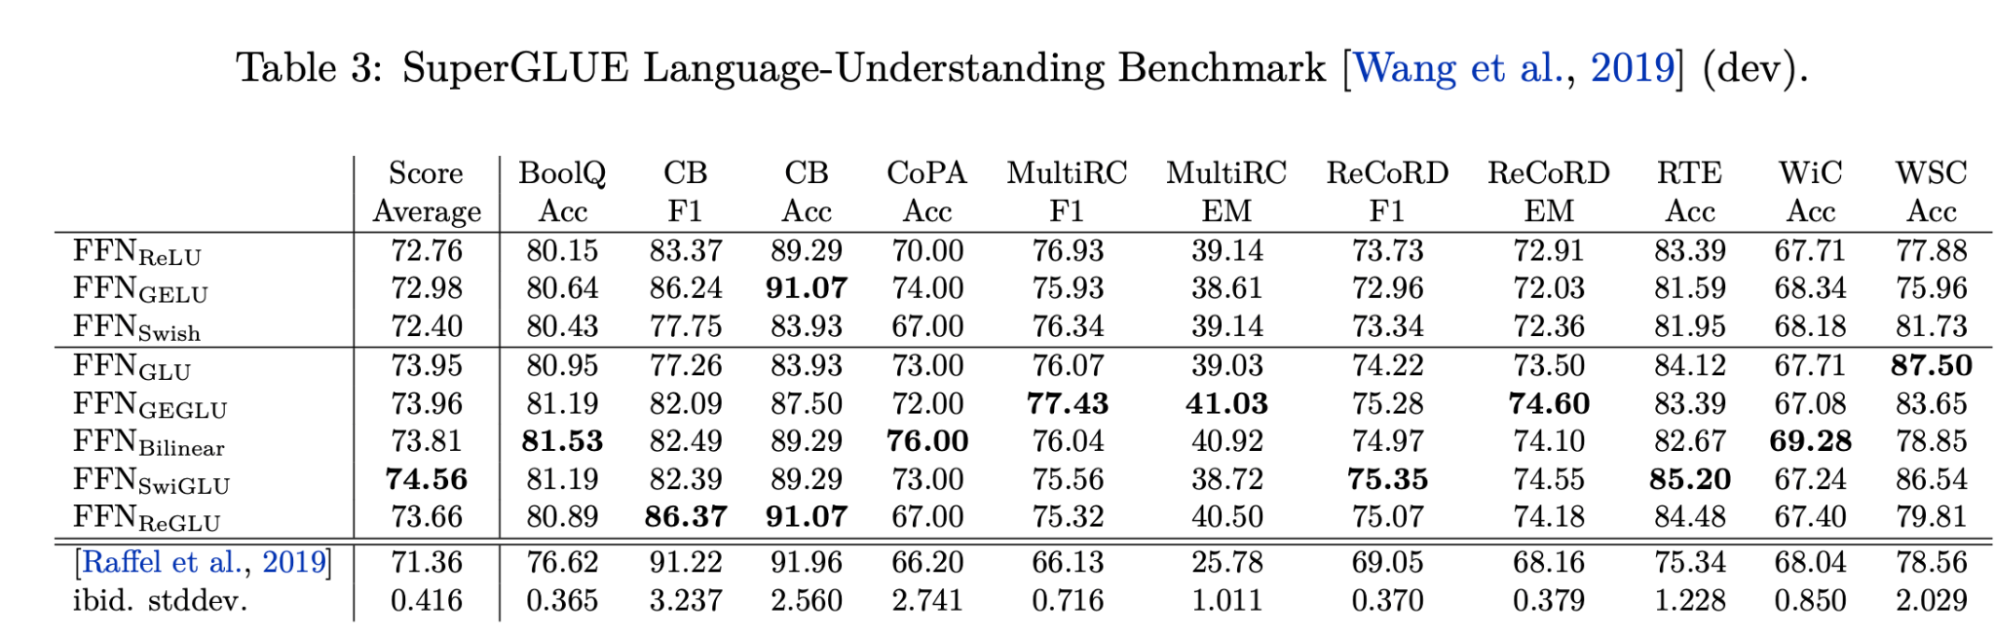

Slide 18
Finally, generate the next token
select a token based on an designed decoding algorithm
Decoder
Linear Projection (LM head)
Tokenizer decoding (mapping id to token)
final embedding (logits)
Vocab logits (128000-d)
Next token

Slide 19
Lab time!
Github: https://github.com/Huan80805/MediaTek2024

Slide 20
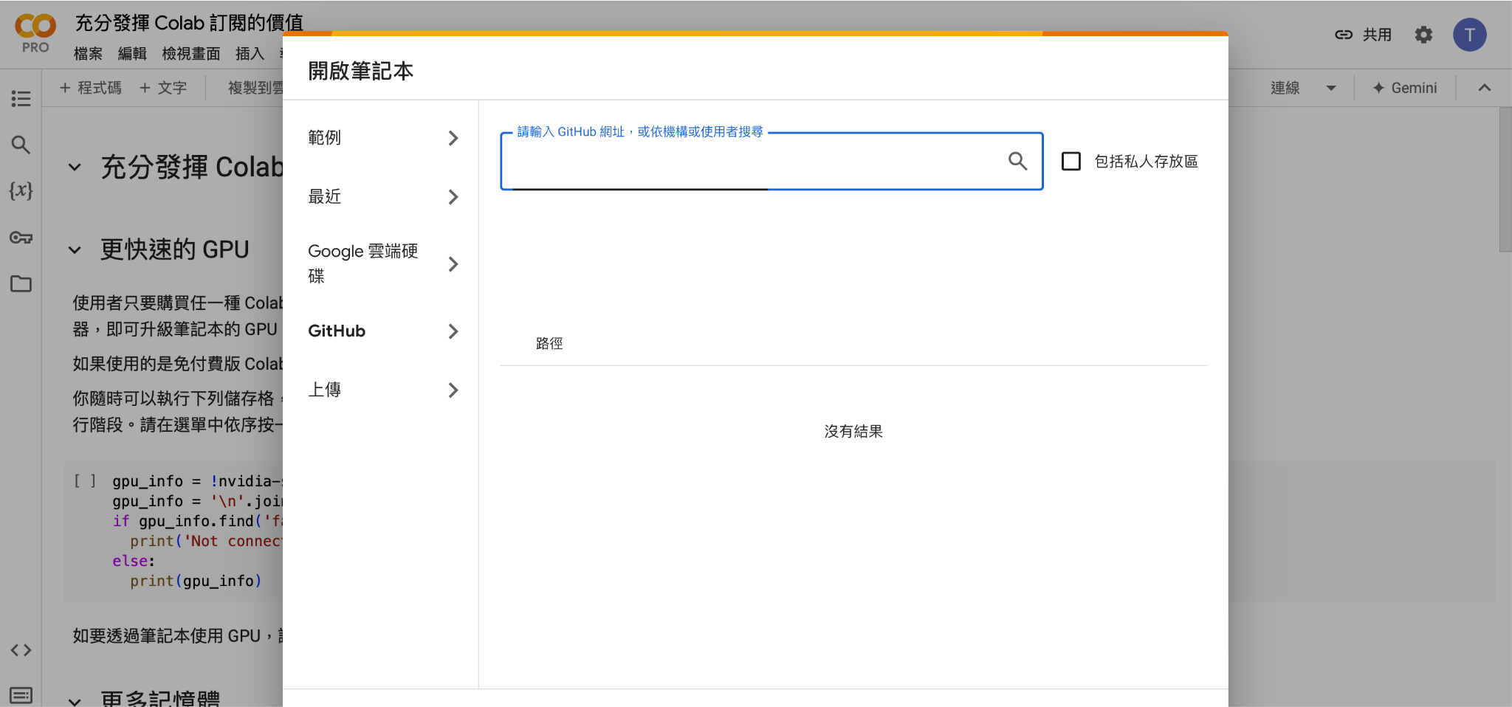
Search: colab
Open colab
Login your google account
Choose Github

Slide 21
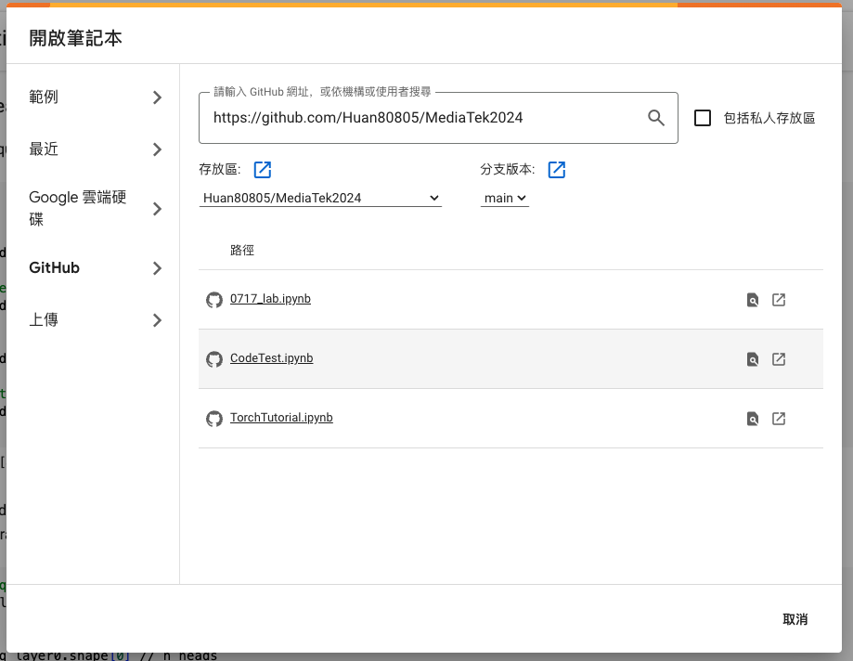
Search the github url: https://github.com/Huan80805/MediaTek2024
不要點選“包括私人存放區”
choose “0717_lab.ipynb”

Slide 22
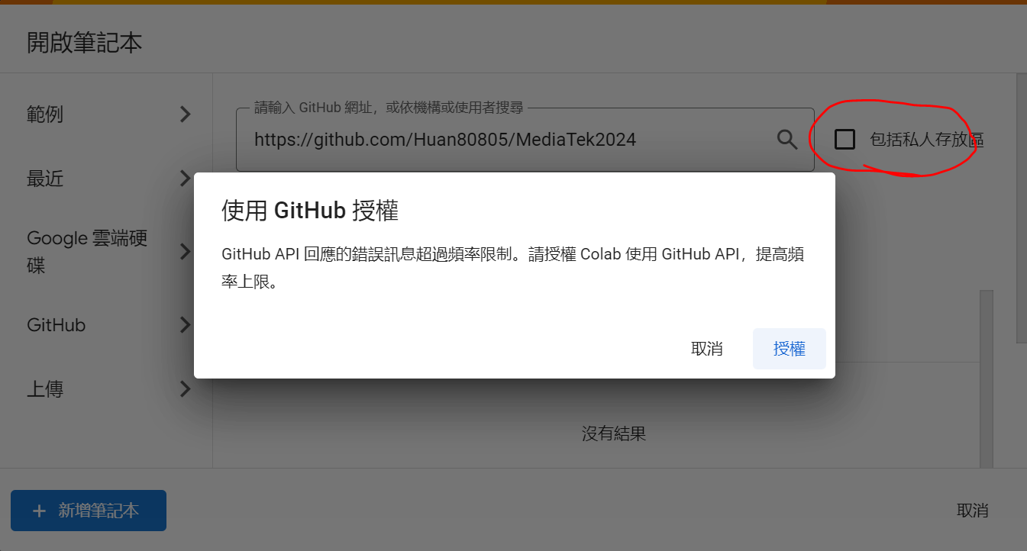
若遇到此錯誤訊息，請過5-10分鐘後再嘗試

Slide 23
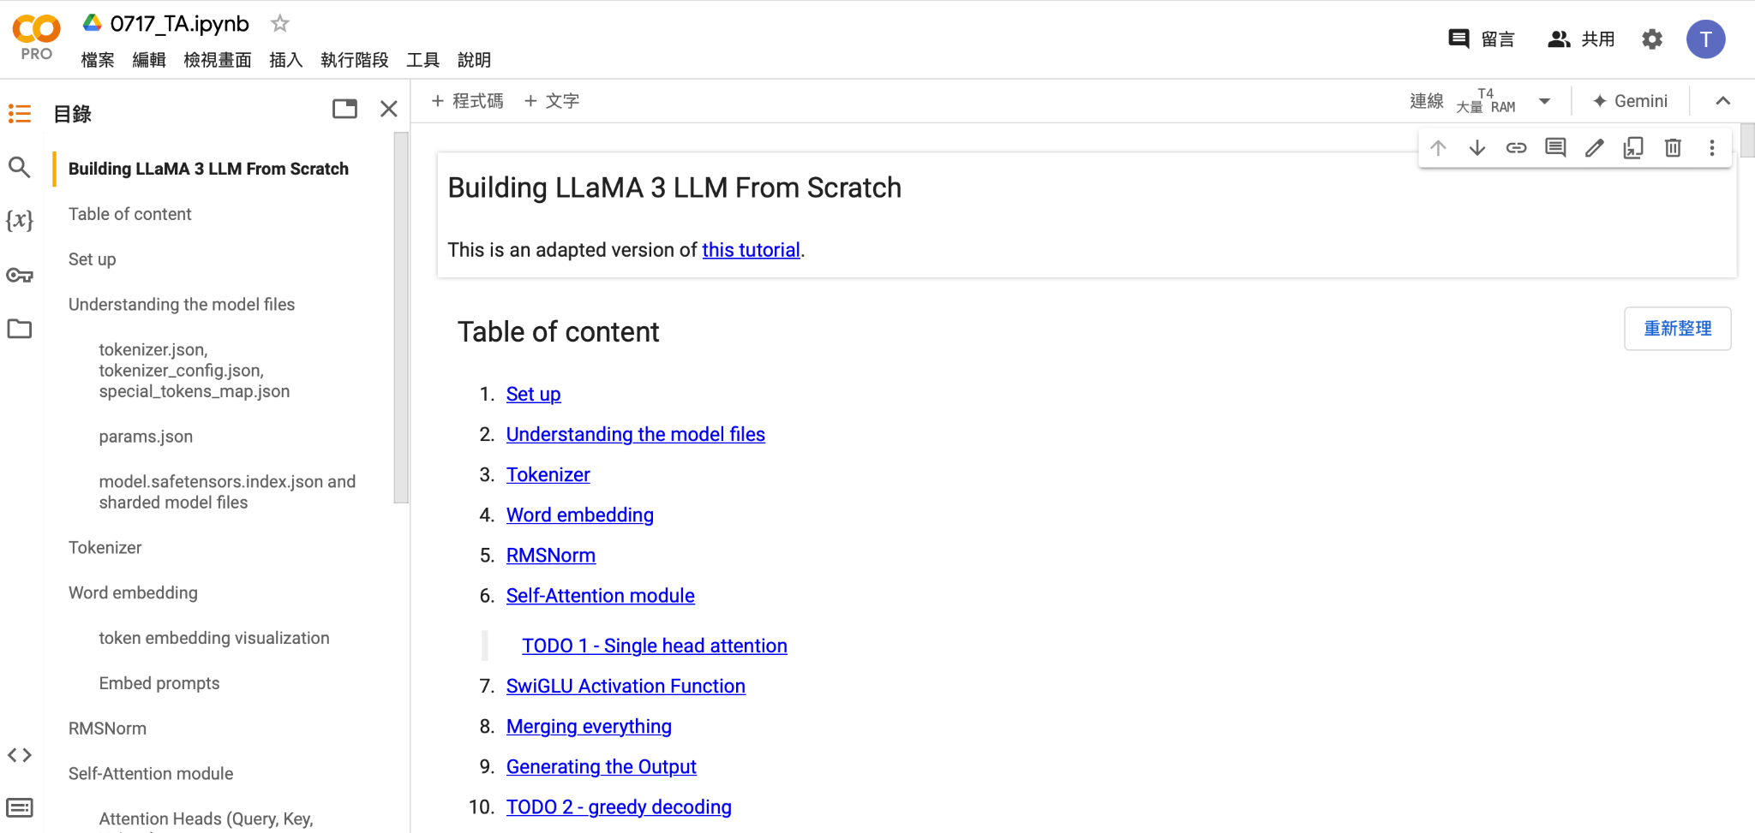
成功開啟後你會看到這個頁面

Slide 24
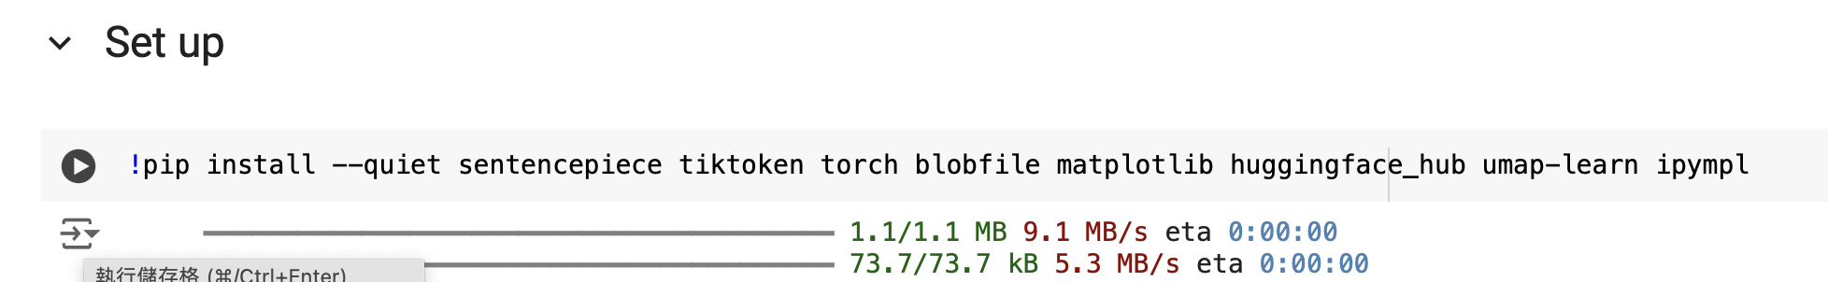
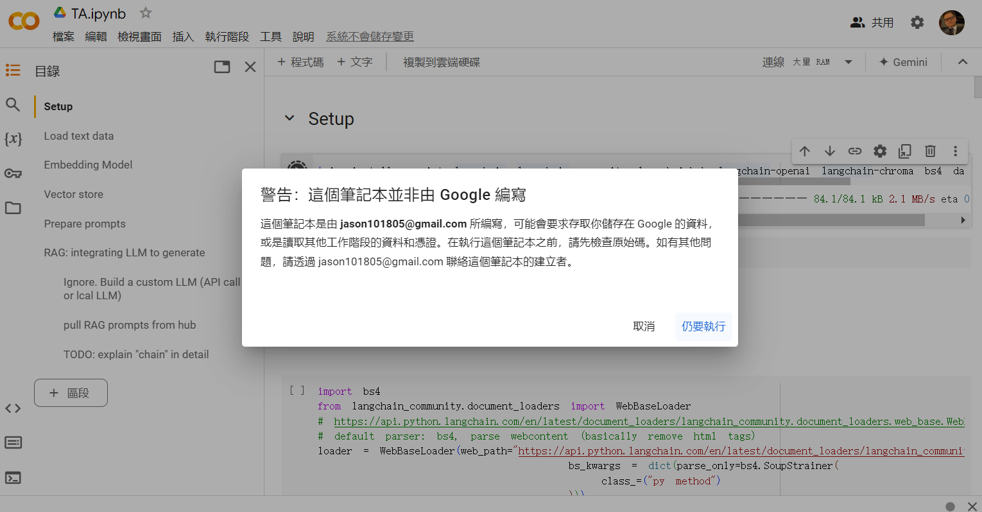
登入後確認執行按鈕是否出現，按play選擇仍要執行

Slide 25
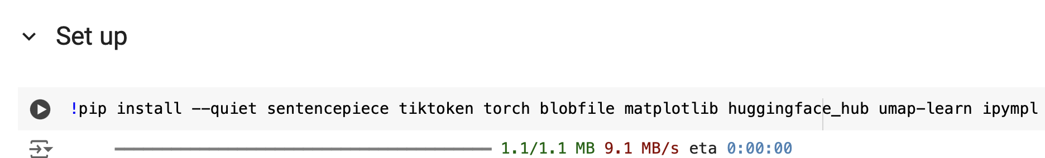
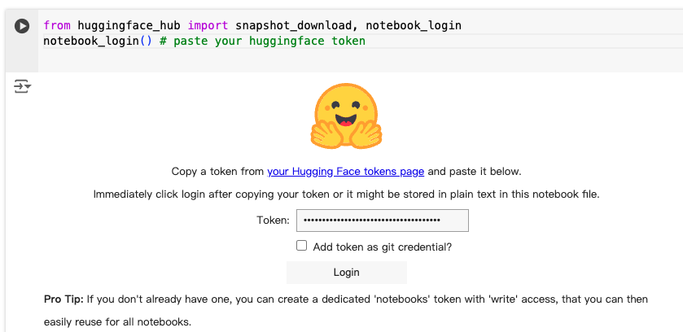
Setup 1: pip install 安裝相關套件
Setup 2: 在notebook上登入huggingface

Slide 26
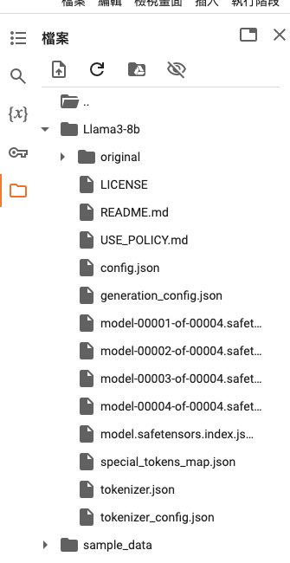
Setup 3: 下載模型
若申請Llama3 access失敗... 請改用非官方的權重: “NousResearch/Meta-Llama-3-8B”
此備案不需要access token, 在下載模型時將
”meta-llama/Meta-Llama-3-8B”替換成”NousResearch/Meta-Llama-3-8B”即可
下載成功後確認資料夾內有Llama3權重

Slide 27
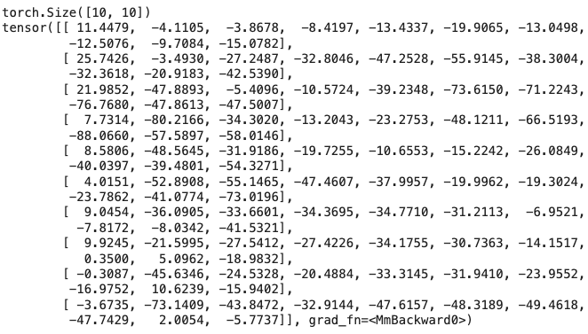
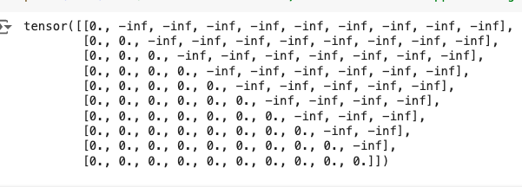
TODO 1 - implement self-attention
1-1: QK matrix multiplication
1-2: create attention mask

Slide 28
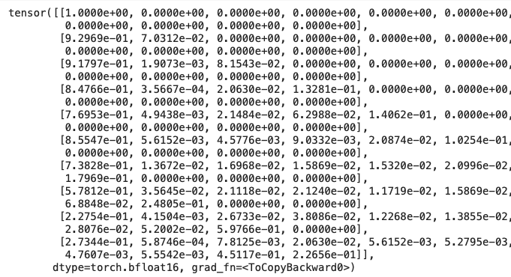
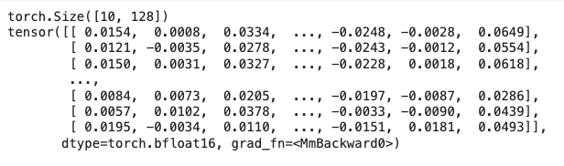
TODO 1 - implement self-attention
1-3: softmax to get probability
1-4: compute attention output

Slide 29
Decoding algorithms
LLM can predict the next token, but what we want is a whole sequence What decoding does is choose the suitable next token in each step and autoregressively do so, until reaching EOS Common decoding strategies: 1. greedy decoding 2. beam search 3. sampling top-p sampling top-k sampling

Slide 30
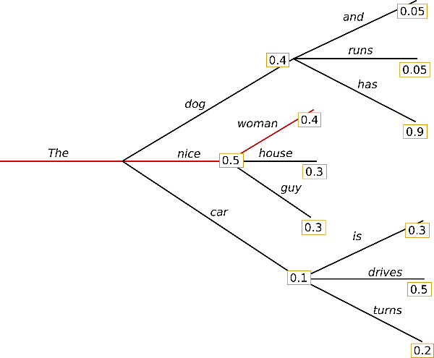
Greedy decoding
Pick the most probable token in each step feature： 1. often repeat itself e.g. I am who I am who I am … 2. some times miss the most probable “sequence” e.g. The dog has v.s. The nice woman

Slide 31
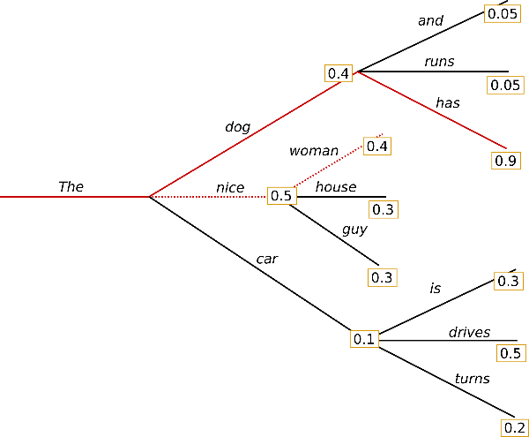
Beam search
Keep top-k candidates (k is called beam size), choose the most probable sequence in the final step feature： 1. Still repeat itself, but better when compared with greedy decoding. 2. Sometimes ”repetition penalty” is used to improve quality

Slide 32

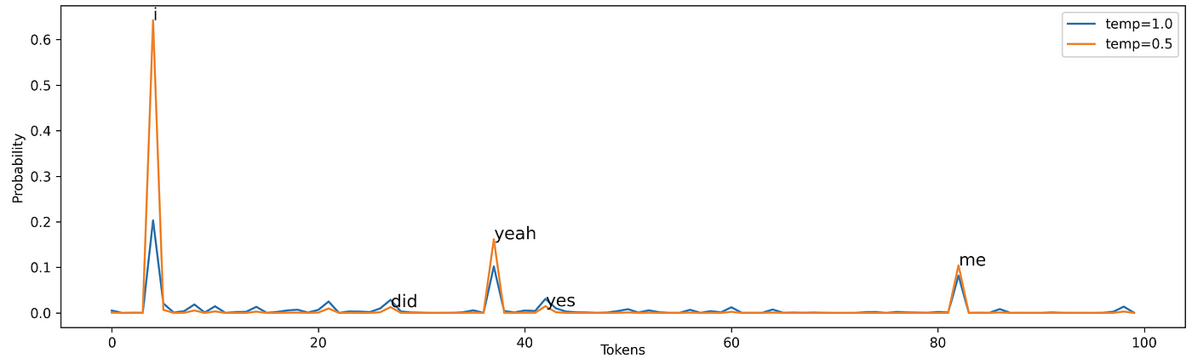
Sampling
Based on current token probability, pick the next toiken randomly features: 1. increase the generation diversity, particularly suitable for open-ended generation 2. every token can be selected → may accidentally select weird token 3. “temperature” is used to adjust probability (lower temperature → prefer tokens with higher probability)

Slide 33
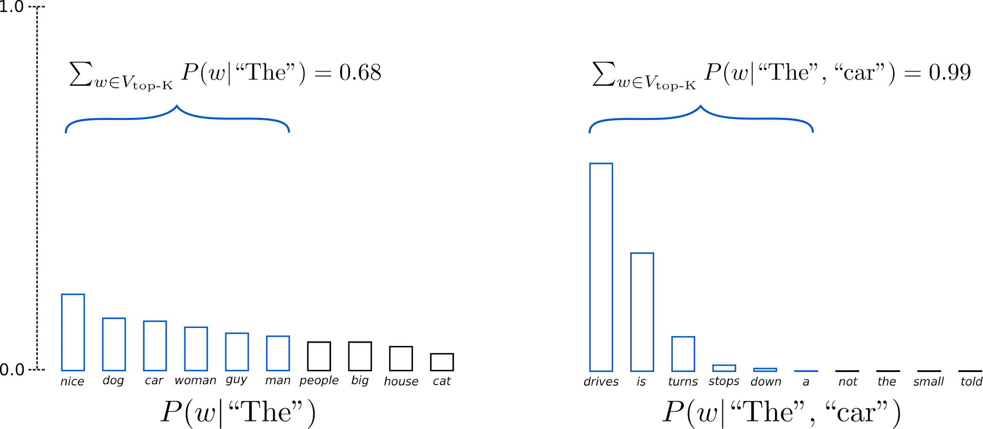
Sampling - top-k sampling
Randomly pick the next token, but only from top-k tokens When k is large, the text is more diverse, the quality is not ensured.

Slide 34
Sampling - top-p sampling (nucleus sampling)
Randomly pick the next token, but only from the most probable tokens whose cumulative probability sum more than p Judge tokens based on their probability instead of the count

Slide 35
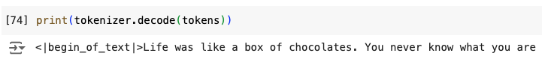
TODO 2- greedy decoding

Slide 36
補充資料
Transformer walkthrough with Colab: https://github.com/markriedl/transformer-walkthrough/tree/main
Decoding strategies implementation with Colab: https://colab.research.google.com/drive/19CJlOS5lI29g-B3dziNn93Enez1yiHk2
Survey of LLMs (~2023.12): https://arxiv.org/abs/2303.18223

